Slide 1
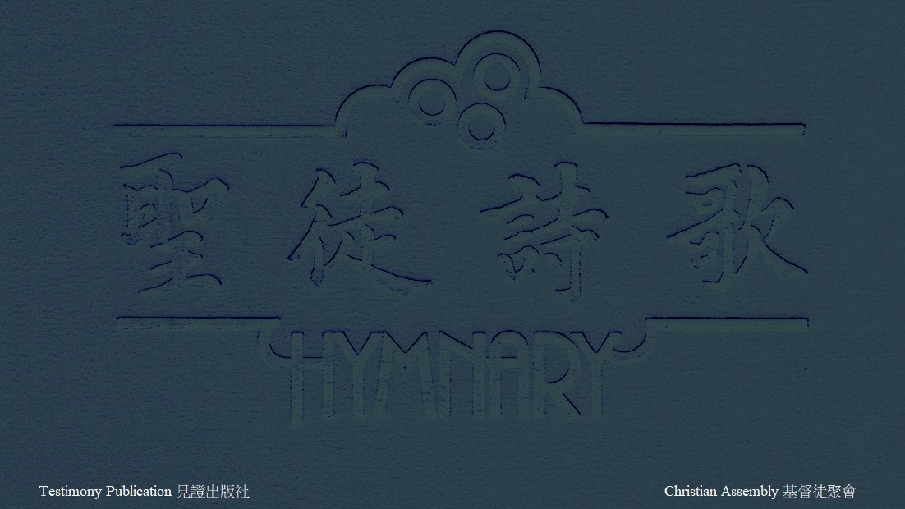
H606 因為神愛世人 FOR GOD SO LOVED THE WORLD (1/1)
因為神愛世人，捨了獨生愛子；
For God so loved the world, He gave His only Son
釘死在十架上，使我脫離罪勢。
To die on Calv’ry’s tree, from sin to set me free;
有日，祂要再來，何等尊貴榮耀！
Some day He’s coming back - what glory that will be！
主的大愛真奇妙！
Wonderful His love to me！

